Slide 1
¡Costa Rica!

Slide 2
Fun Facts about Costa Rica
What is the nickname for native Costa Ricans?
Ticos/Ticas
How many provinces does Costa Rica have?
Costa Rica is divided into seven provinces: San Jose, Alajuela, Heredia, Cartago, Guanacaste, Puntarenas and Limon
What is the nation’s tallest Volcano?
Irazu is the tallest volcano in Costa Rica at 11,259 feet.
(Poas Volcano has the second widest crater in the world (nearly one mile in diameter), and Arenal Volcano is one of the ten most active volcanoes in the world.)
What is the official language of Costa Rica?
Spanish!

Slide 3
¿Quién soy yo?
Karen Tharrington
6th year at NC State
Wolfpack graduate
Leading trips since 1999
Lots of travel experience
Studied Spanish just like you!
Loves to dance

Slide 4
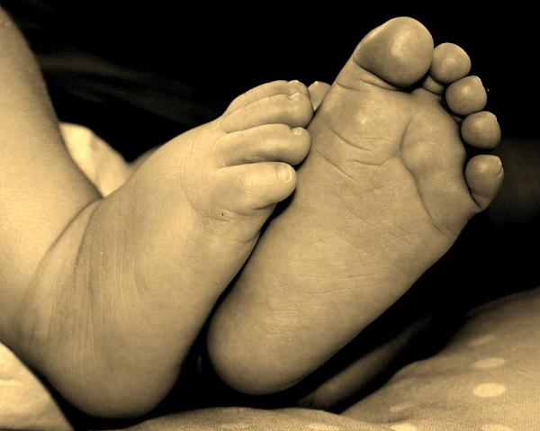
¿Quién eres tú?
Name
Reason for studying abroad
Travel experience
Something fun or that we should know about you

Slide 5
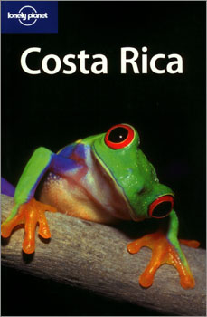
Recommended Reading

Slide 6
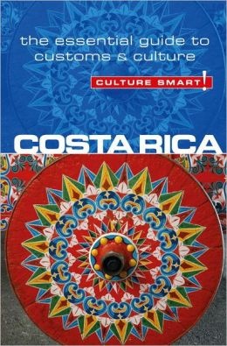
Costa Rican Culture

Slide 7
Recommended:

Slide 8
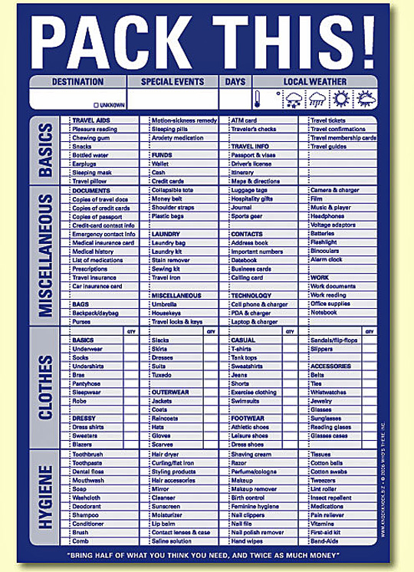
Notes:
(look at list from Study Abroad)
Suggestions for packing:
Hiking boots
Hiking pants/shorts
Hat

Slide 9
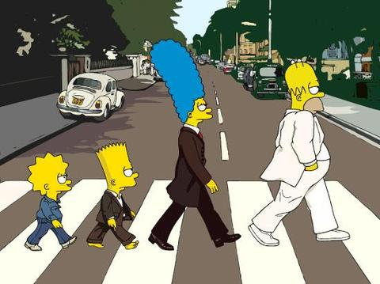

Slide 10
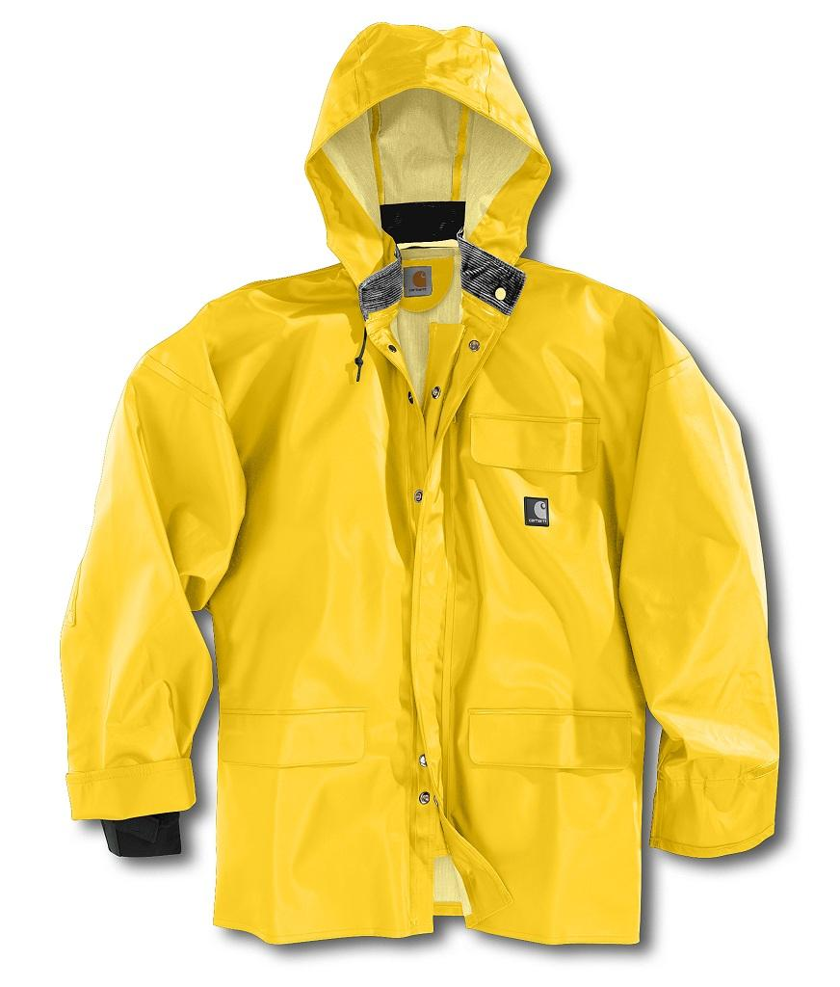
Notes:
Bring proper clothing! People go to Costa Rica for two things: Beaches and Rainforests. Both are wet so pack accordingly. Layers!!!
Long sleeve t-shirts
Raincoat that is packable
T-shirts
Jeans
Hiking pants
It is the rainy season – it rains each afternoon
Bring shorts (pants that turn into shorts are great)
Good socks and lots of them
Bathing suit for beach
Shoes for inside the house; going to class; beach; hiking
*Goodwill – don’t bring anything flashy that says “hey, I’m a rich American!”

Slide 11
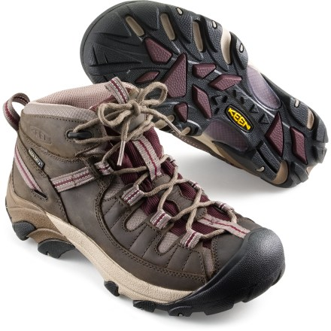
Notes:
Bring comfortable shoes!! We will be hiking, so don’t think flip flops are going to cut it. Plus, it rains in the afternoon and you want to protect your feet!

Slide 12
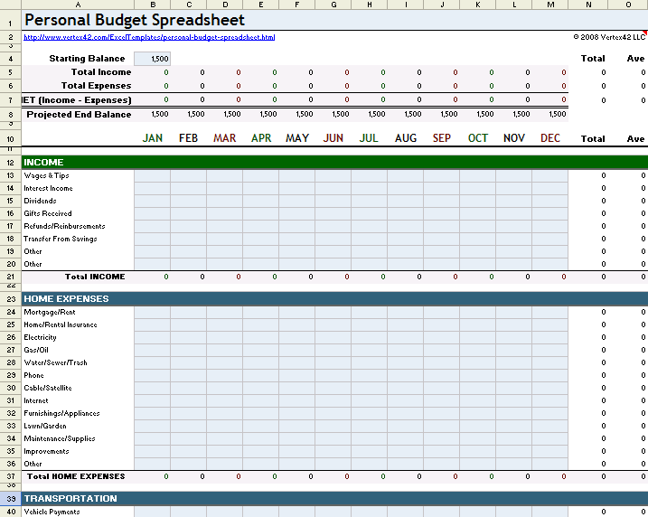
Notes:
Do a personal budget to track your spending. If you have extra money for excursions, give Roy a shout.
Study Abroad website
$500 spending money

Slide 14
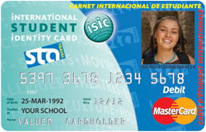
Optional

Slide 15
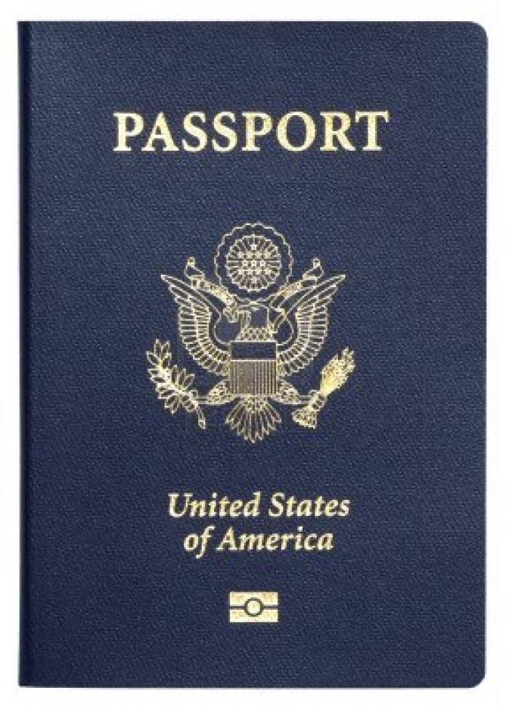
Not Optional!
Notes:
Make 2 copies of the page with your information and picture. Leave one at home with family members, and bring one with you. That way, if you lose your passport, you have a copy to help expedite the process.

Slide 16
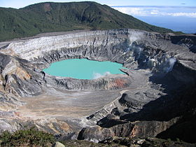
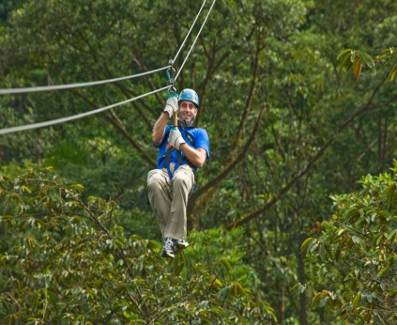
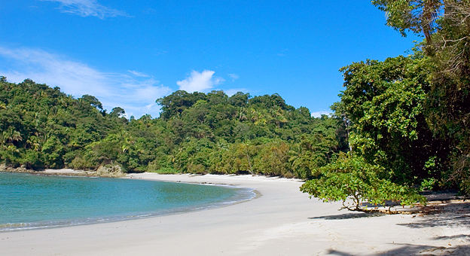
16 de mayo: llegar a San José
17 de mayo: Orientación de UCR
18 de mayo: El centro/el mercado ($)
20 de mayo: clases empiezan
Los fines de semana:
Volcán Poás y Cataratas de la Paz
Canopy Tour
Manuel Antonio
Notes:
Go over general itinerary
Transporte Incluye Microbus Toyota Coaster Modelo 2007 Capacidad 25 personas A/C
Recogemos en el aeropuerto con rotulo de NC State
Transporte a la Universidad de CR, Distribución de los estudiantes a las casas que los hospedan
(Favor enviar lista de casas con números de telefono para montar una ruta)
Transporte UCR - Volcán Poás y Cataratas de la Paz (La Paz Waterfall Garden)
Transporte UCR - Canopy Tour ( se sugiere FossiLand ) o Mahogaby usted deside
Transporte Manuel Antonio 2 noches 3 días con todos los recorridos necesarios
Transporte UCR - Aeropuerto
Seguros en caso de accidente o cambio de unidad por algun inconveniente
Entrada Volcán Poás, Recorrido guiado, Entrada a La Paz Waterfall Garden, Almuerzo Buffet
Tour en FossilLsand Hiking, Canopy, rapeling, Tarzan Swing and 1.200 mts Water sleigh y almuerzo
Entrada a Manuel Antonio, Hospedaje en Hotel Plaza Yara con desayuno incluido, guía en todo el recorrido
Paseo en Catamarán en Manuel Antonio con Almuerzo Frío
Ademas en todo el recorrido, agua y meriendas para todos

Slide 17
Things to do in San José
El mercado
Museo de Oro Precolombino
Museo de Jade
Pueblo Antiguo
Campo de café
Teatro Nacional
Museo Nacional
Parque Nacional
Antigua Estación Ferrocarril
Centro Costarricense de Ciencias y Cultura
Museo de Arte Costarricense

Slide 18
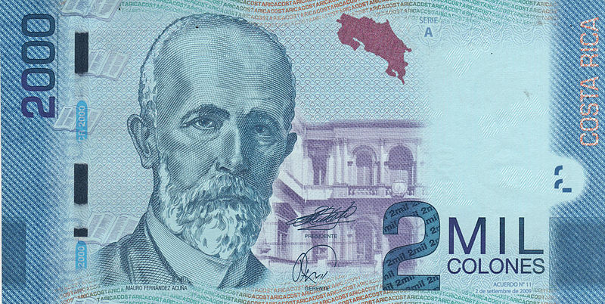
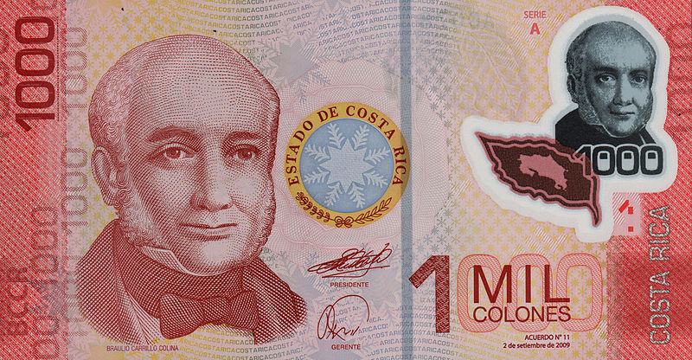
Money
1.00 USD | = | 499.201 CRC
Notes:
ATMs
It’s increasingly easy to find cajeros automáticos (ATMs) in Costa Rica, even in the smallest towns. The Visa Plus network is the standard, but machines on the Cirrus network, which accepts most foreign ATM cards, can be found in larger cities and tourist towns. In these areas, ATMs also dispense US dollars, which is convenient for payments at top-end hotels and tour agencies. Note that some machines will only accept cards held by their own customers.
Cash & Currency
The Costa Rican currency is the colón (plural colones, ₡), named after Cristóbal Colón (Christopher Columbus). Bills come in 500, 1000, 5000 and 10,000 notes, while coins come in denominations of 5, 10, 20, 25, 50 and 100. Note that older coins are larger and silver, while newer ones are smaller and gold-colored – this is often a source of confusion for travelers fresh off the plane.
Read more: http://www.lonelyplanet.com/costa-rica/practical-information/money-costs#ixzz2OZng4X4T

Slide 19
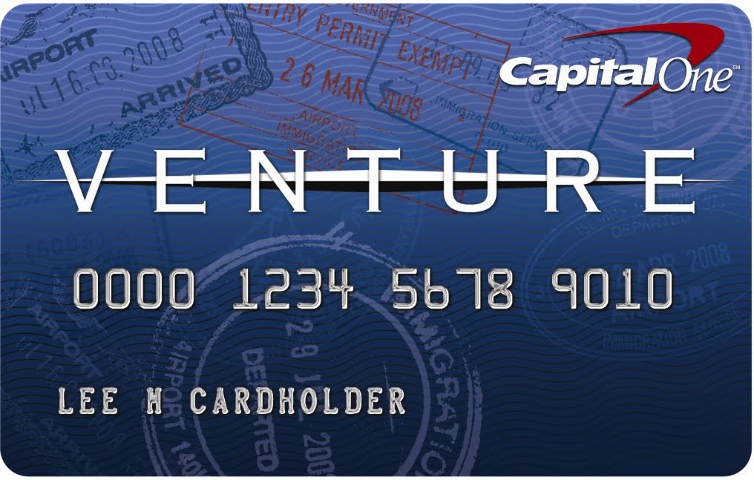
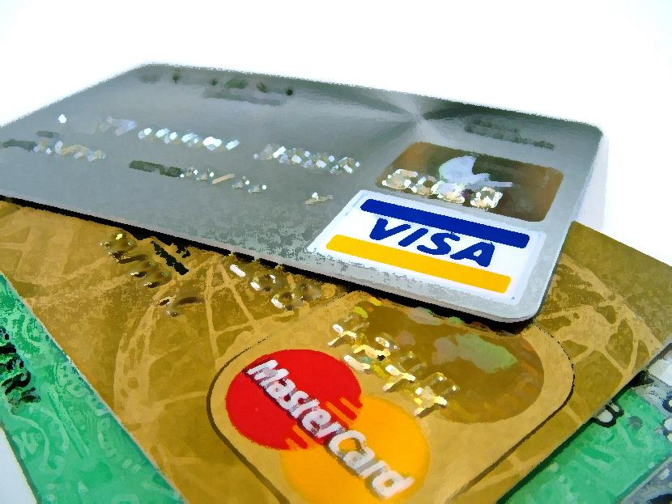
Credit Cards
No international fees ☺
Notes:
Call bank ahead of time to make sure it will work and so they don’t put a hold on your account. Do not use prepaid cards (you lose it, it’s gone). NO TRAVELER’S CHEQUES!!
Credit Cards
You can expect a transaction fee on all international credit-card purchases. Holders of credit and debit cards can buy colones and sometimes US dollars in some banks, though you can expect to pay a high transaction fee. Cards are widely accepted at some midrange and most top-end hotels, as well as top-end restaurants and some travel agencies. All car rental agencies accept credit cards.
Exchanging Money
All banks will exchange US dollars, and some will exchange euros and British pounds; other currencies are more difficult. Most banks have excruciatingly long lines, especially at the state-run institutions (Banco Nacional, Banco de Costa Rica, Banco Popular), though they don’t charge commissions on cash exchanges. Private banks (Banex, Banco Interfin, Scotiabank) tend to be faster. Make sure the dollar bills you want to exchange are in good condition or they may be refused.
Read more: http://www.lonelyplanet.com/costa-rica/practical-information/money-costs#ixzz2OZnktVkW

Slide 20
Notes:
Anyone celebrating a birthday?

Slide 21
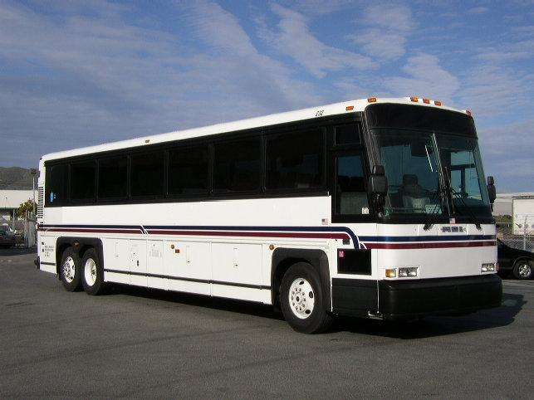
Notes:
Transport to and from airport – we all go together. It is hired just for us ☺
Costa Rica does not use addresses so you don’t want to be on your own to find your host family’s house.
For all excursions, please be on time. We have the bus for a certain number of hours, so if we leave late, it eats into our excursion time.
How well do you travel on busses? Do you get sick? Bring Bonine. Do you like music? Bring iPod. Want to sleep? Bring eyeshades.

Slide 22
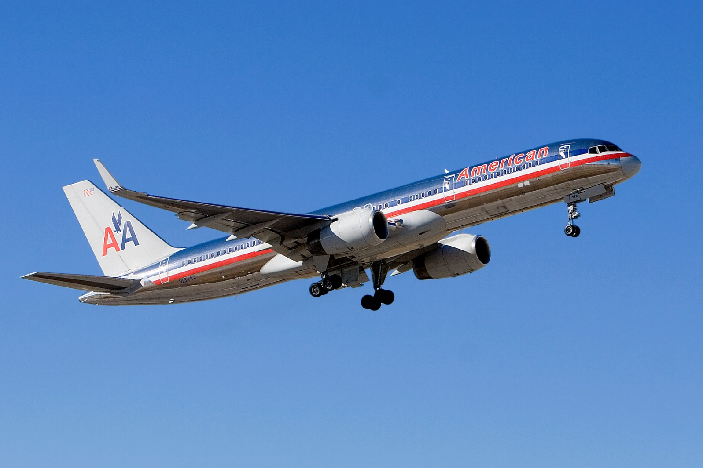
Flights

Slide 23
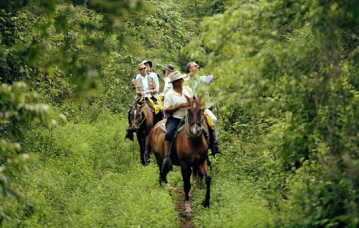
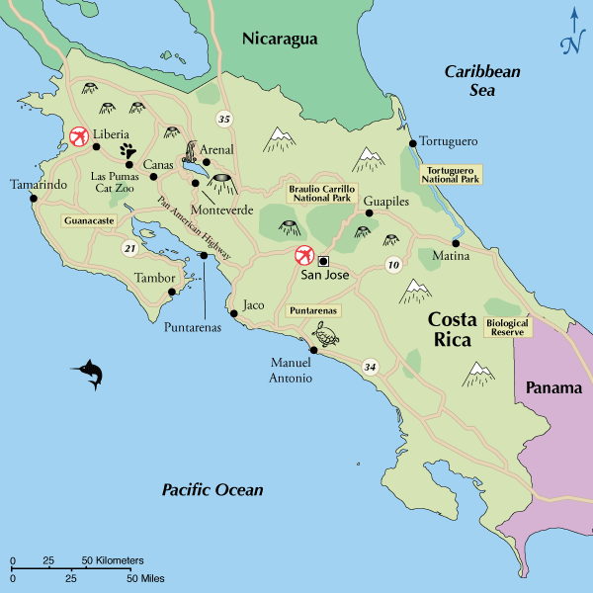
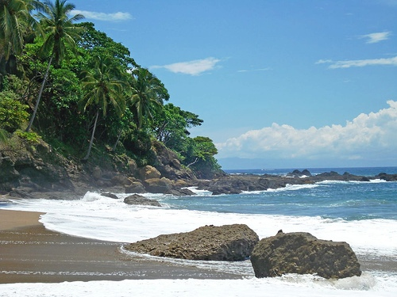
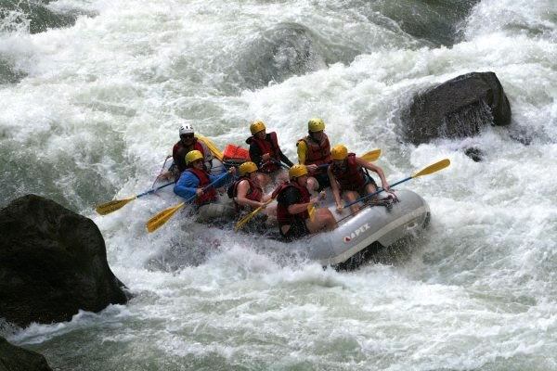
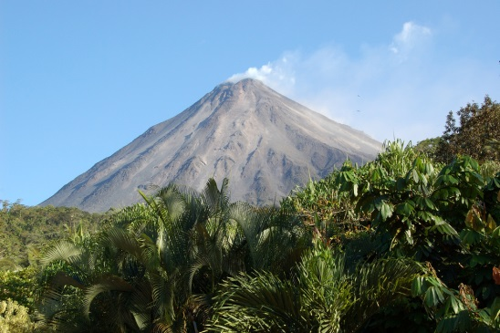
Travel after program?

